Slide 1
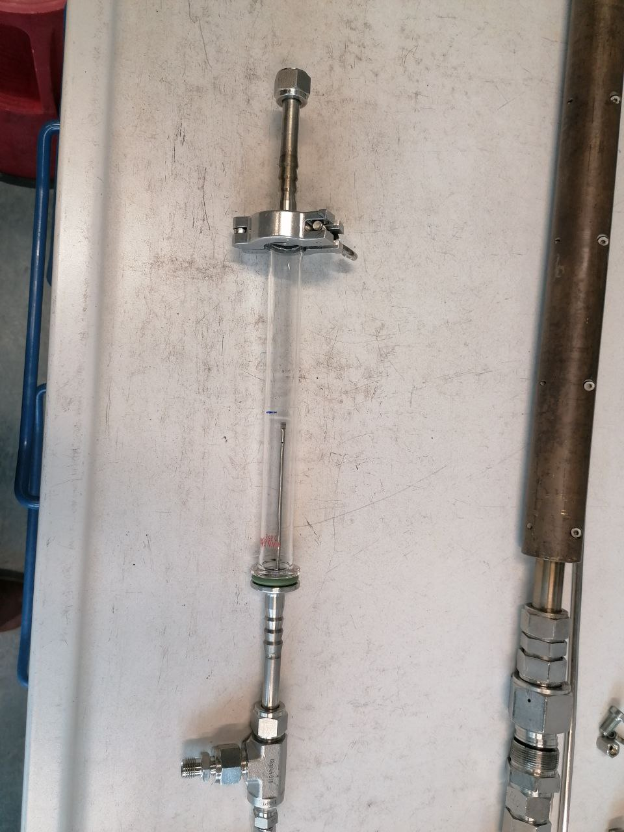
Low flow setup (old, short bed)
Inlet
Placement of catalyst bed
Outlet

Slide 2
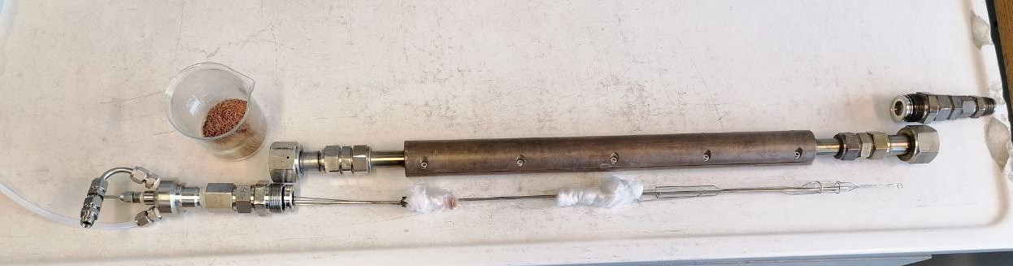
First try of high flow setup, using glass wool to hold pellets in place resulted in high pressure drop, out of range for the sensor

Slide 3
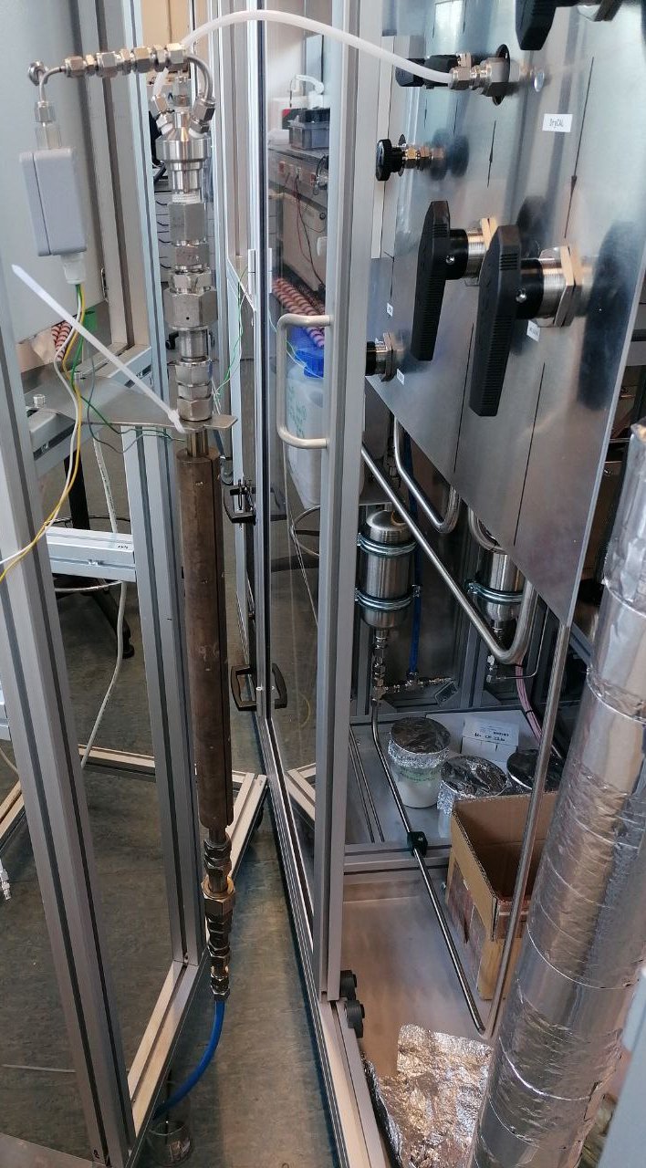
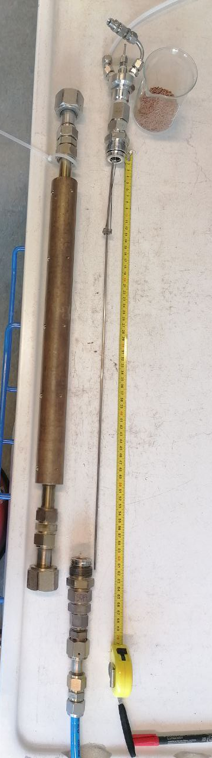
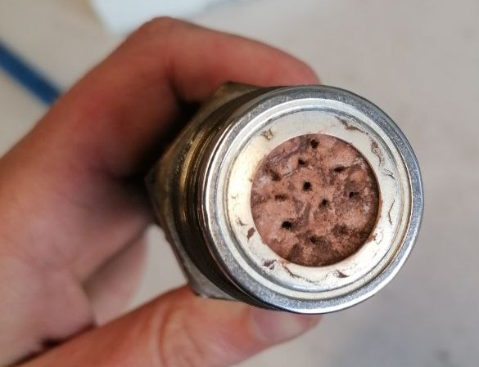
High flow setup (new)
Inlet
Sensor
Outlet „sieve“ to hold pellets in place
Placement of catalyst bed
Outlet

